Slide 1
Airbnb New User Bookings
Group 11:
Nikhil Kashid
Sumeet Gaglani

Slide 2
Problem Statement:
In this challenge, we are given a list of users along with their demographics, web session records, and some summary statistics. You are asked to predict which country a new user's first booking destination will be. All the users in this dataset are from the USA.
There are 12 possible outcomes of the destination country: 'US', 'FR', 'CA', 'GB', 'ES', 'IT', 'PT', 'NL','DE', 'AU', 'NDF' (no destination found), and 'other'. Please note that 'NDF' is different from 'other' because 'other' means there was a booking, but is to a country not included in the list, while 'NDF' means there wasn't a booking.

Slide 3
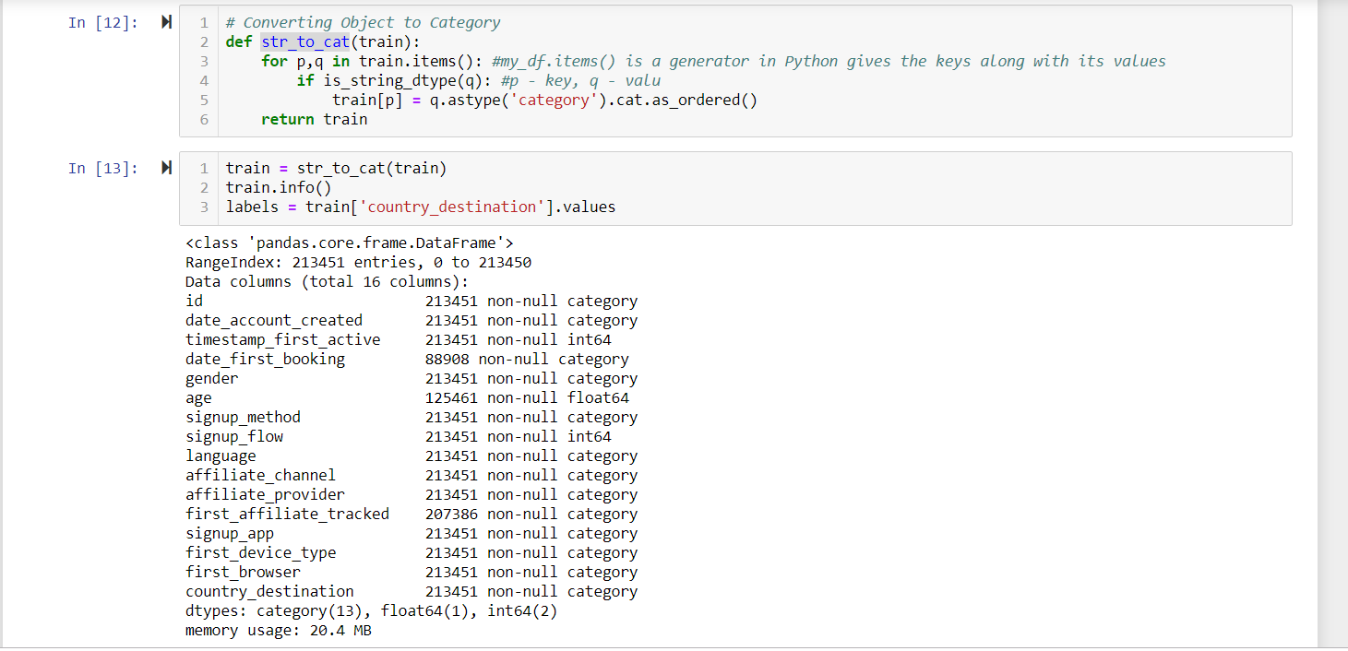
Converting data from object to categorical data type:

Slide 4
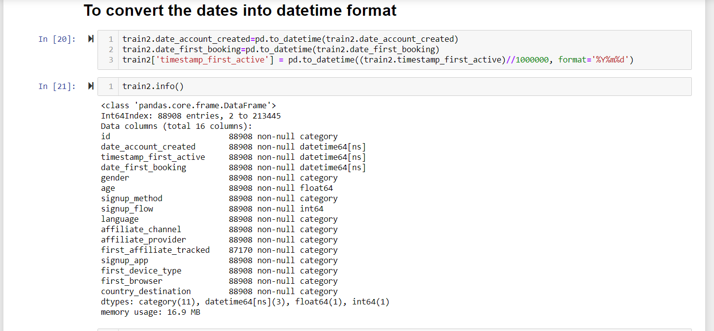
Conversion of the dates into date-time format:

Slide 5
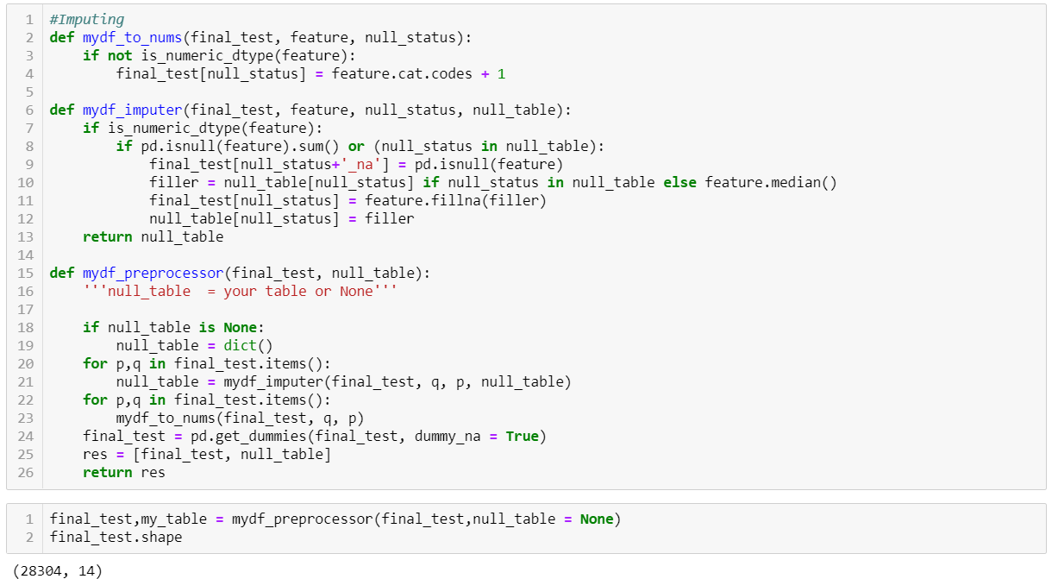
Imputations:

Slide 6
Visualizations:

Slide 7
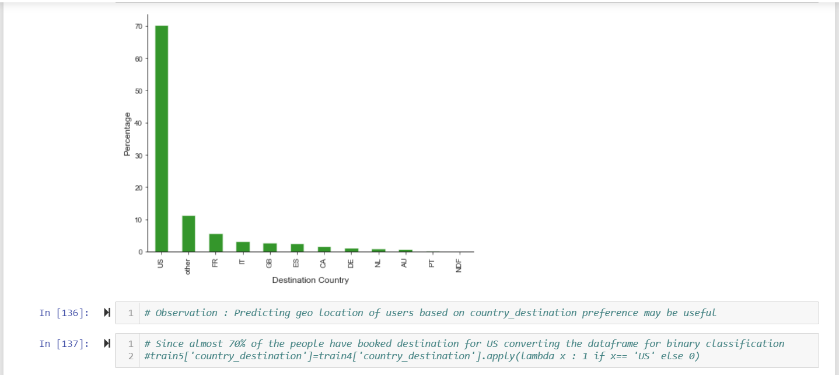
1) Country and destination on training data

Slide 8
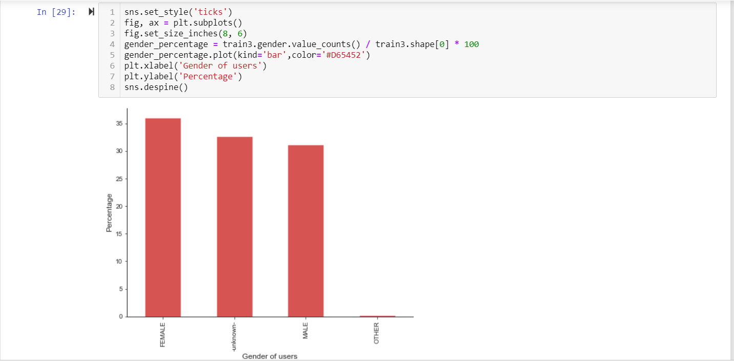
2) Gender wise split :

Slide 9
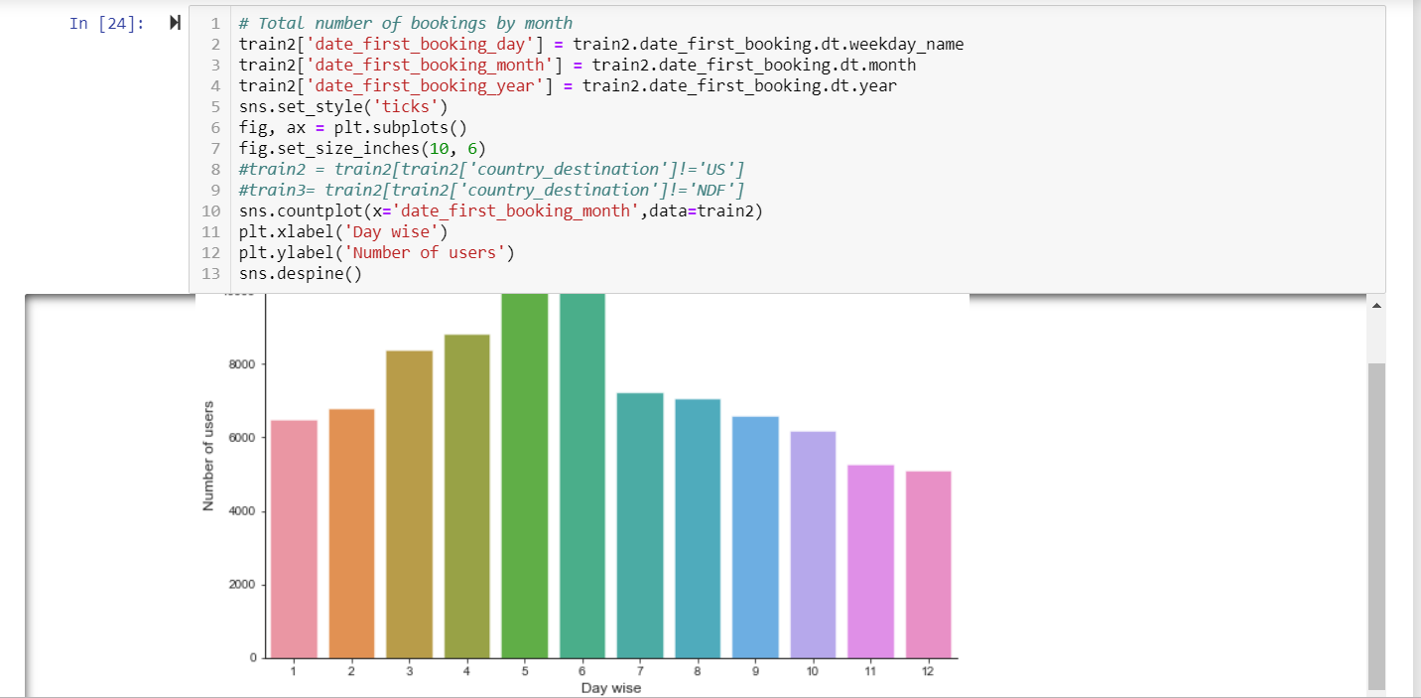
3) Total number of bookings by month

Slide 10
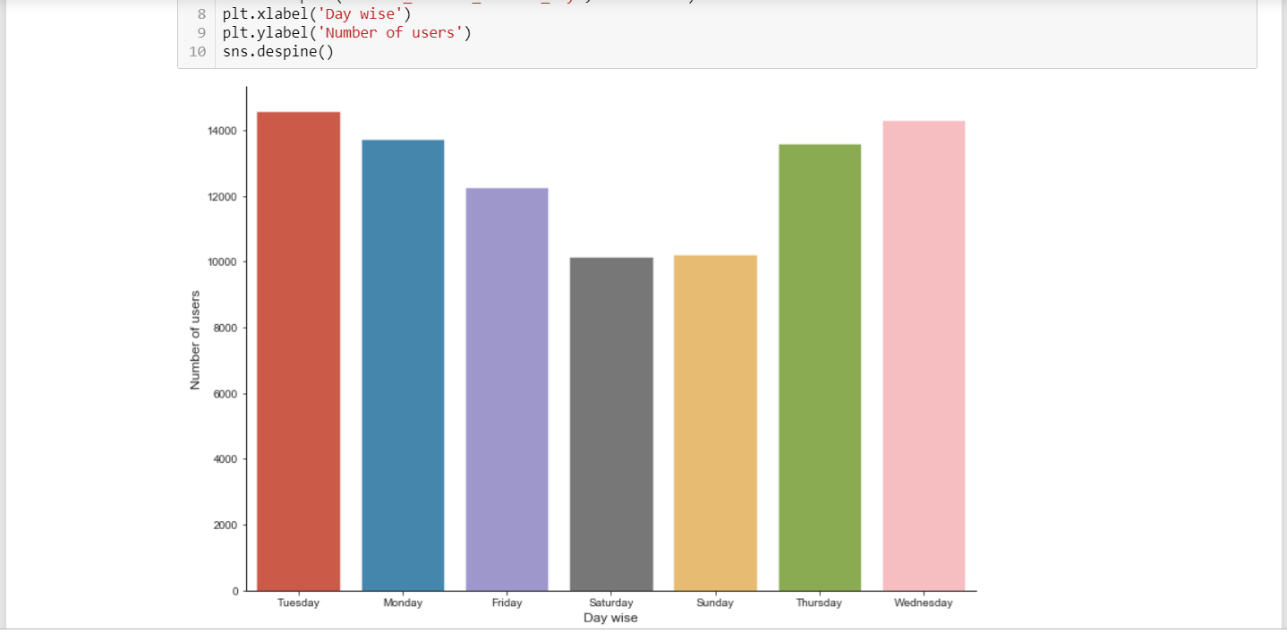
4)Day wise bookings

Slide 11
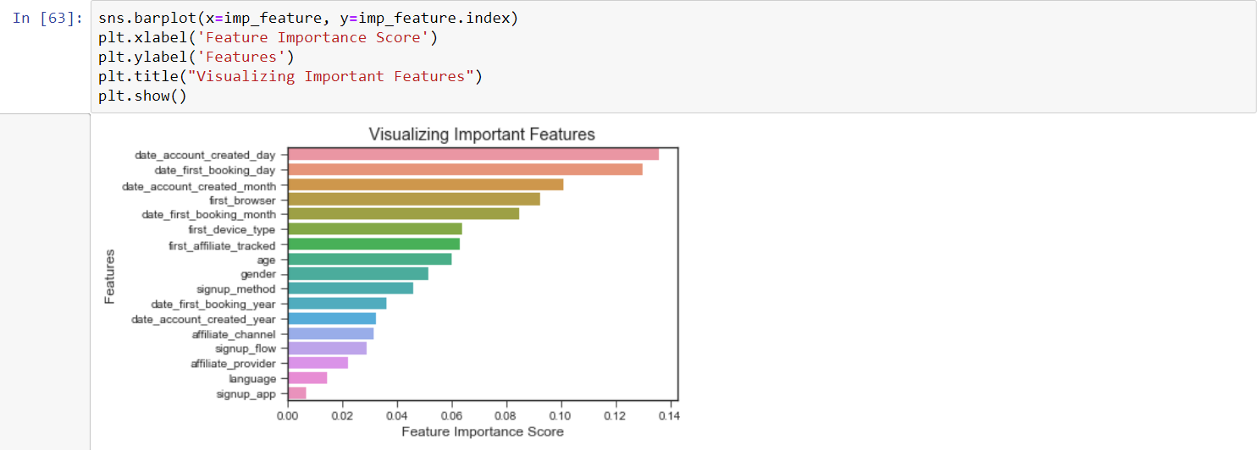
FEATURE IMPORTANCE

Slide 12
Algorithms Used and their outcomes:

Slide 13
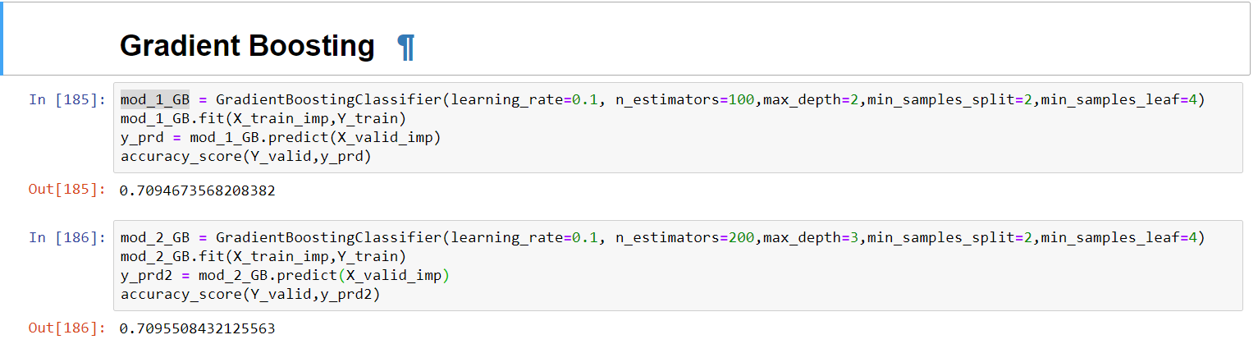
Gradient Boosting:

Slide 14
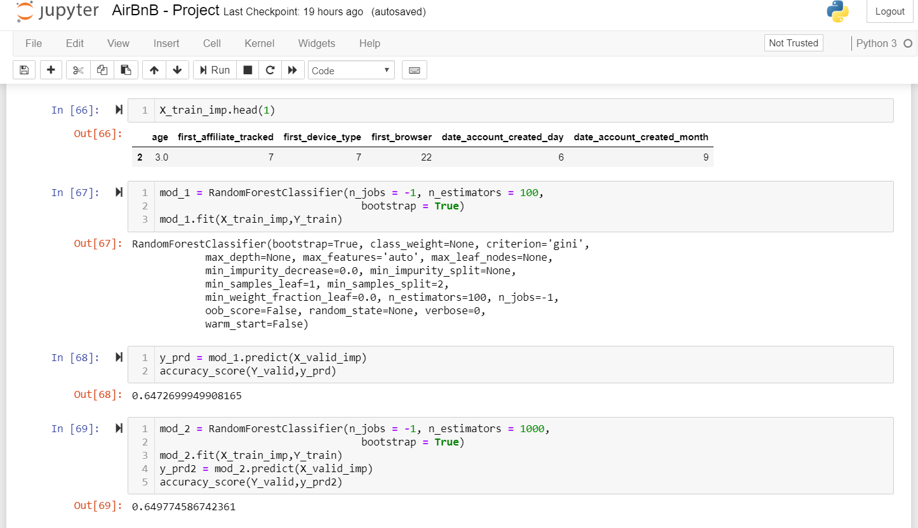
Random forest classifier:

Slide 15
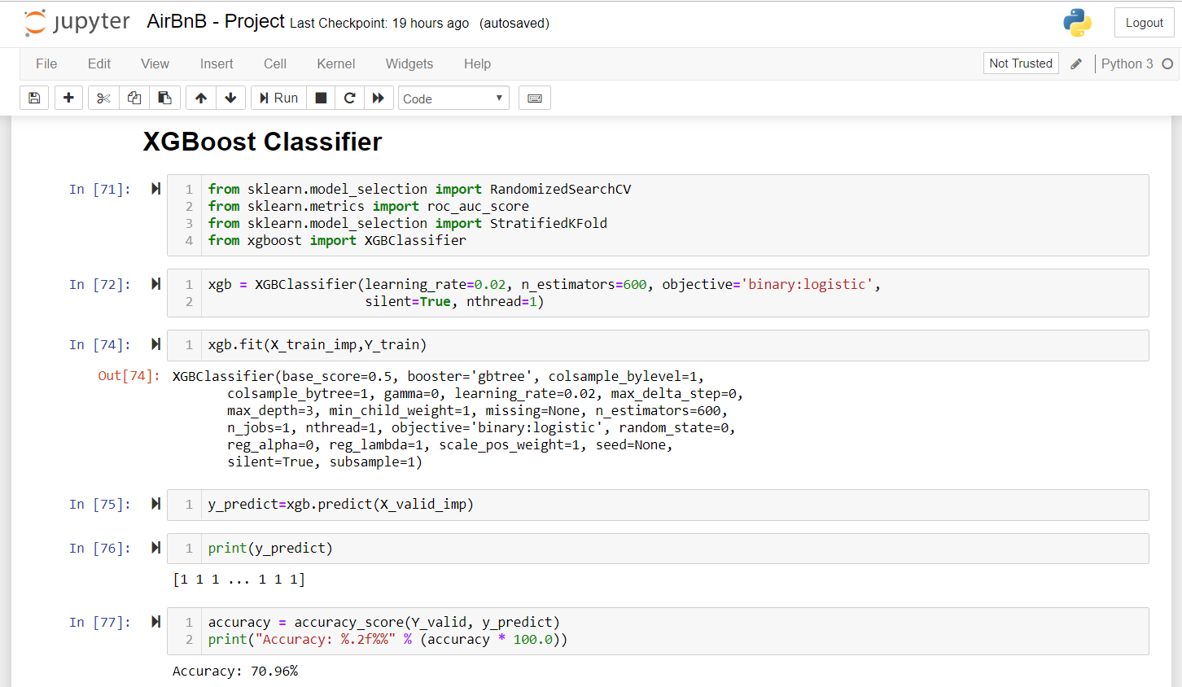
XGBoost performance Classifier

Slide 16


